Slide 1


COSMOS Cultivate Resilient Smart Objects for Sustainable City Applications
Intelligent Things management within the IoT
Orfefs Voutyras (ICCS/NTUA)

Slide 2
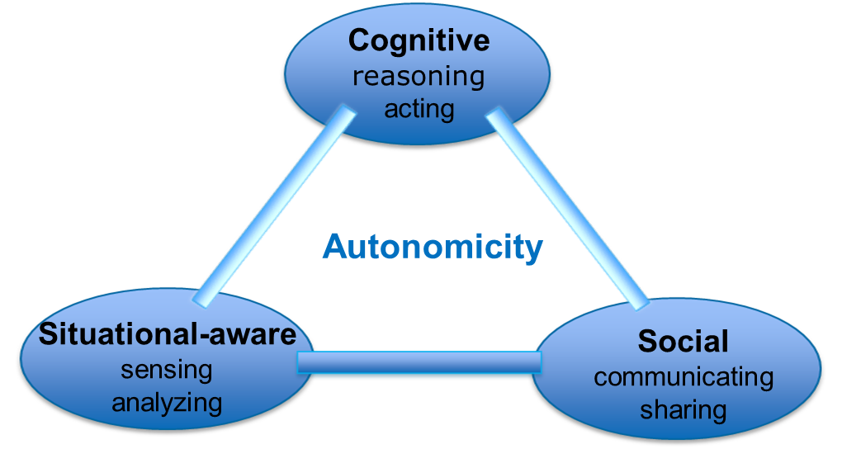
Design and Architecture
Achieving Autonomicity via Situational-Aware, Cognitive and Social Things

Slide 3
Design and Architecture
Monitor-Analyze-Plan-Execute: An autonomic control loop as proposed by IBM.
In addition to the MAPE components, an autonomic manager also contains a Knowledge block that is connected to all four of the MAPE functional blocks, producing a MAPE-K control loop.
Situational-aware
Cognitive
A
P
M
E
Knowledge Component
MAPE-K loop

Slide 4
Design and Architecture
know-Best
Wisdom
e.g. best experience-sharing patterns
learning
Knowledge
know-How
planning
e.g. experience
Information
know-What
analysis
e.g. events collected by the CEP
monitoring
Data
know-Nothing
raw-data collected through e.g IoT-services
The COSMOS DIKW pyramid

Slide 5
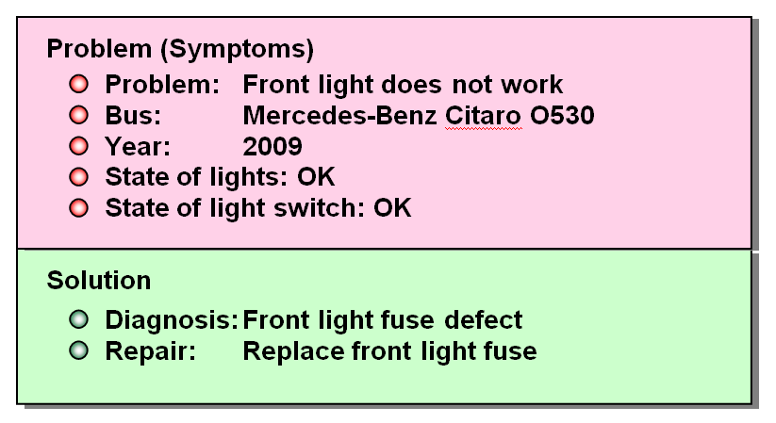
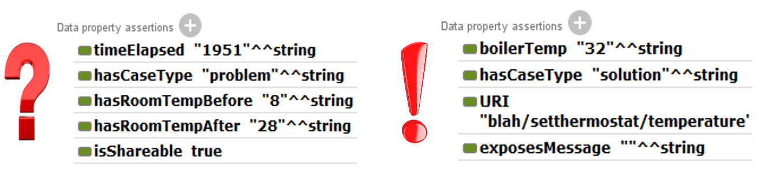
The Planner
Case-Based Reasoning is the process of solving problems based on past experience. In more detail, it tries to solve a Case (a formatted instance of a problem) by looking for similar cases from the past and reusing the solutions of these cases to solve the current one.
CBR reflects human reasoning and is the easiest approach for the developers and the one that can be used in a huge variety of domains. The concept of adapting past solutions is developed.

Slide 6
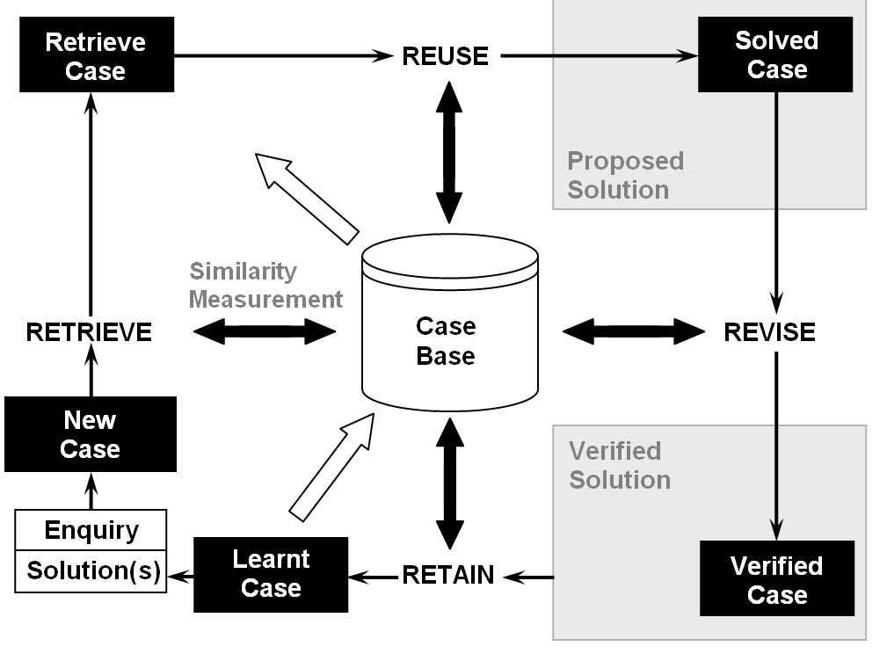
The Planner
A general CBR cycle may be described by the following four Processes:
RETRIEVE the most similar case or cases
REUSE the information and knowledge in that case to solve the problem
REVISE the proposed solution
RETAIN the parts of this experience likely to be useful for future problem solving
The CBR cycle

Slide 7

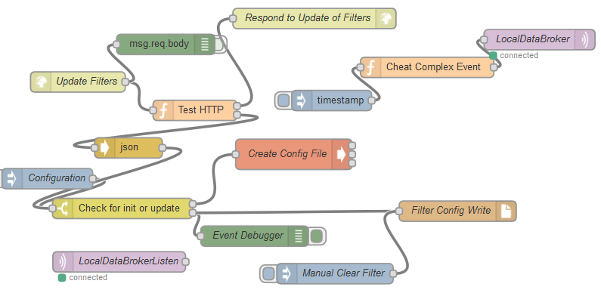
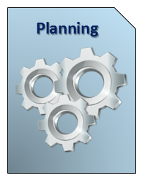
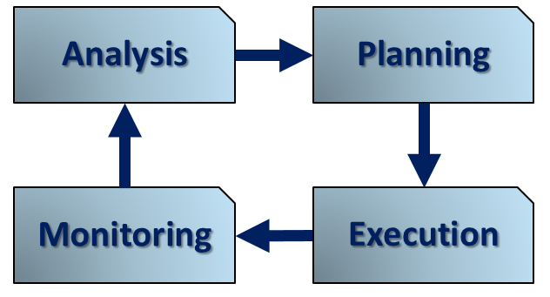

Linking Problems to Solutions: Technical Details, Implementation & Enabling Technology
Things can learn and adapt:
Reasoner based on the Case Based Reasoning technique.
Solving problems based on past experience.
CBR reflects human reasoning and is the easiest approach for developers and can be used in a huge variety of domains.
Many I/O options to choose from:
Using Node-RED flows, App developers can use custom configuration files to link problems to solutions (remote REST calls).
The knowledge structure we propose enables agnostic and dynamic interconnection (e.g. stop App if sensor malfunctions).
Notes:
A general CBR cycle may be described by the following four Processes: RETRIEVE the most similar case or cases, REUSE the information and knowledge in that case to solve the problem, REVISE the proposed solution, RETAIN the parts of this experience likely to be useful for future problem solving.
Creation of the initial set of Cases (e.g. from historical data), Creation of new Cases through the CBR cycle, Connection of Cases with Topics and their activation (+ Node-RED)
Flow creating custom CE published in the VE MB for the Planner. Triggers CBR based parametric Service call for sensor state based filtering of User oriented, actuatable Services.
Progress that has lead into a dynamic, CE based protection of actuatable Services with User input endpoints, so as to address concerns of wrongful unsupervised actuations.
An example of the above mentioned capability is the use of programmatical Service endpoint block filters which can be activated based on stored information of data sensor unreliable transmissions

Slide 8

Thank you! Any questions?
Orfefs Voutyras (ICCS/NTUA)
www.iot-cosmos.eu
The research leading to these results has received funding from the EC Seventh Framework Programme FP7/2007-2011 under Grant Agreement n° 609043

